Slide 1

University Unified Login System
Made By-
AASTHA ARORA ( 22070122003 )
AAYUSHA BHATIA ( 22070122004 )
Under the Guidance of
Prof. Usha Jogalekar
SYMBIOSIS INTERNATIONAL (DEEMED UNIVERSITY)
2022-26
Notes:
1

Slide 2

Content
Introduction
Motivation
Statement of Problem / Scope
Objectives of Study
Existing System
Functionalities in our project
Methodology, Tools and Techniques
Results
Conclusion
References
2
Notes:
2

Slide 3
Introduction
In today's digital age, universities rely heavily on online portals for various functions such as accessing financial information, submitting assignments, providing feedback, and checking examination results
Introducing a Centralized University Login System.
Improving Security and User Experience.
Streamlining Access to Services and Resources.
Enhancing Efficiency in Access Management.

Slide 4
Motivation
Enhancing Efficiency, Security, and User Satisfaction.
Addressing Fragmented Logins and Security Risks.
Creating a Cohesive and User-Centric System.
Modernizing Access Management Practices.
Improving Data Security and User Privacy.

Slide 5
Statement of Problem / Scope
Identifying Current Challenges: Disjointed Logins, Security Vulnerabilities.
Scope: Developing a Centralized Login Portal for day-to-day services related to college students.
Goals: Enhancing User Experience, Strengthening Security Measures, Bringing all the important stuff to one place.
Optimizing Access Management for Users and Administrators.

Slide 6
Objectives of Study
Enhance User Experience with Seamless Authentication.
Different functionalities under one platform.
Optimize Access Management for Streamlined Processes.
Integrate Multiple Services under a Unified Framework.

Slide 7
Existing System
Current System Limitations: Disjointed Experiences, Security Risks.
Challenges: User Inconvenience, No centralized Platform.
Goals: Improve Security, Create Cohesive User Experience.
Enhancements Needed for Modern Access Management.
Addressing Security and Usability Concerns.

Slide 8
Functionalities in our project
The functionalities of our project include:
Centralized Login Page: Allows access to registered users only, managed through a MySQL database.
Faculty Directory: Displays faculty phone numbers and information.
Event Calendar: Shows upcoming university events and important dates.
Important Portals: Provides access to key university resources and services.Timetable: Displays class schedules and room assignments.

Slide 9
Methodology, Tools and Techniques
METHODOLOGY:
Agile approach for flexibility and iterative improvements.
User-centric design for usability testing and feedback.
TOOLS:
Frontend: HTML, CSS, JS, QRCode.js
Backend: PHP, Python, MySQL
TECHNIQUES:
Session management for security.
Data encryption for privacy.
Error handling and logging for stability.
Integration with university databases.

Slide 10
Results
Expected Outcomes: Improved User Satisfaction, Enhanced Security.
Evaluation Through User Feedback, Performance Metrics.
Achievements: Streamlined Access Management, Enhanced Security.
Successful Implementation of Advanced Authentication Features.
Positive Impact on User Experience and System Efficiency.

Slide 11
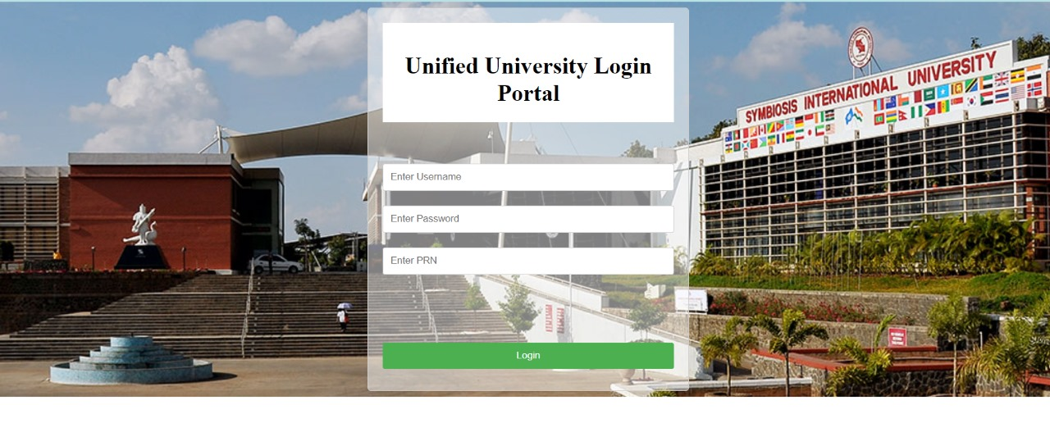
Results

Slide 12
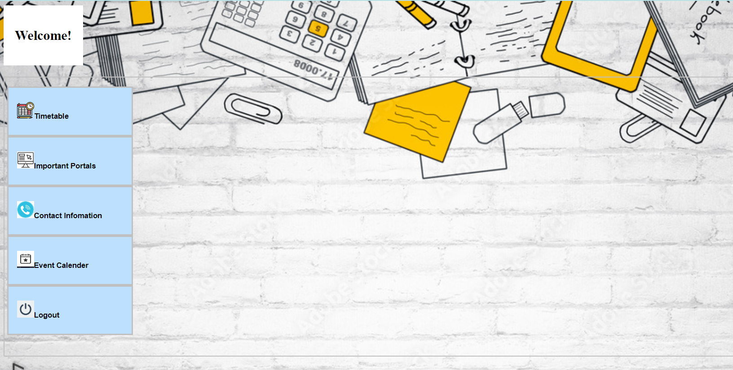
Results

Slide 13
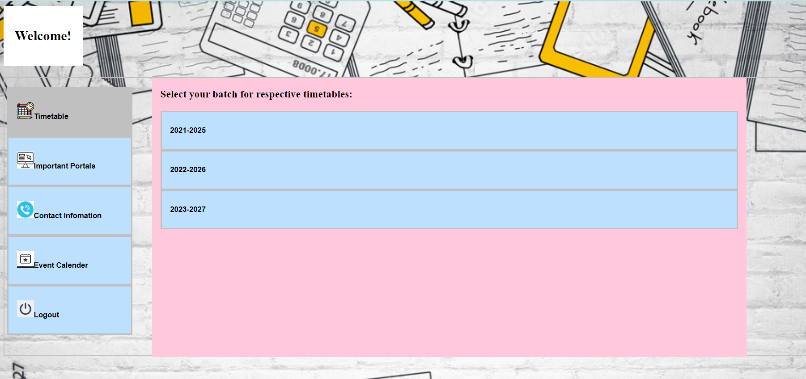
Results

Slide 14
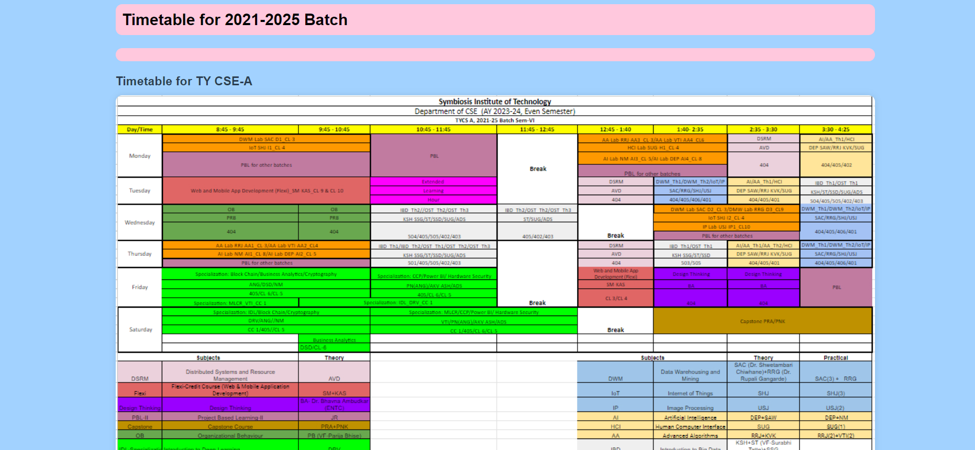
Results

Slide 15
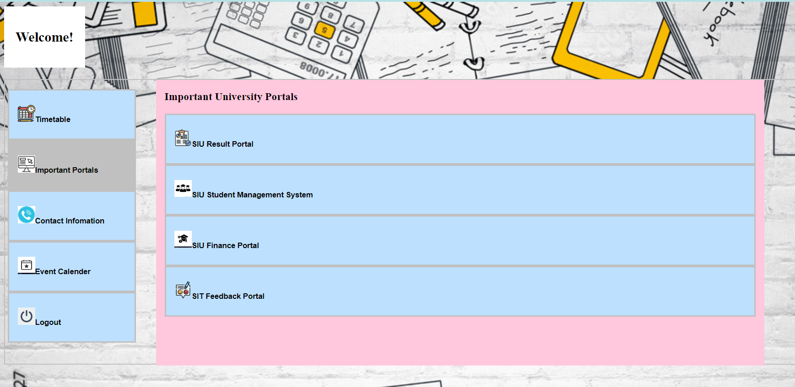
Results

Slide 16
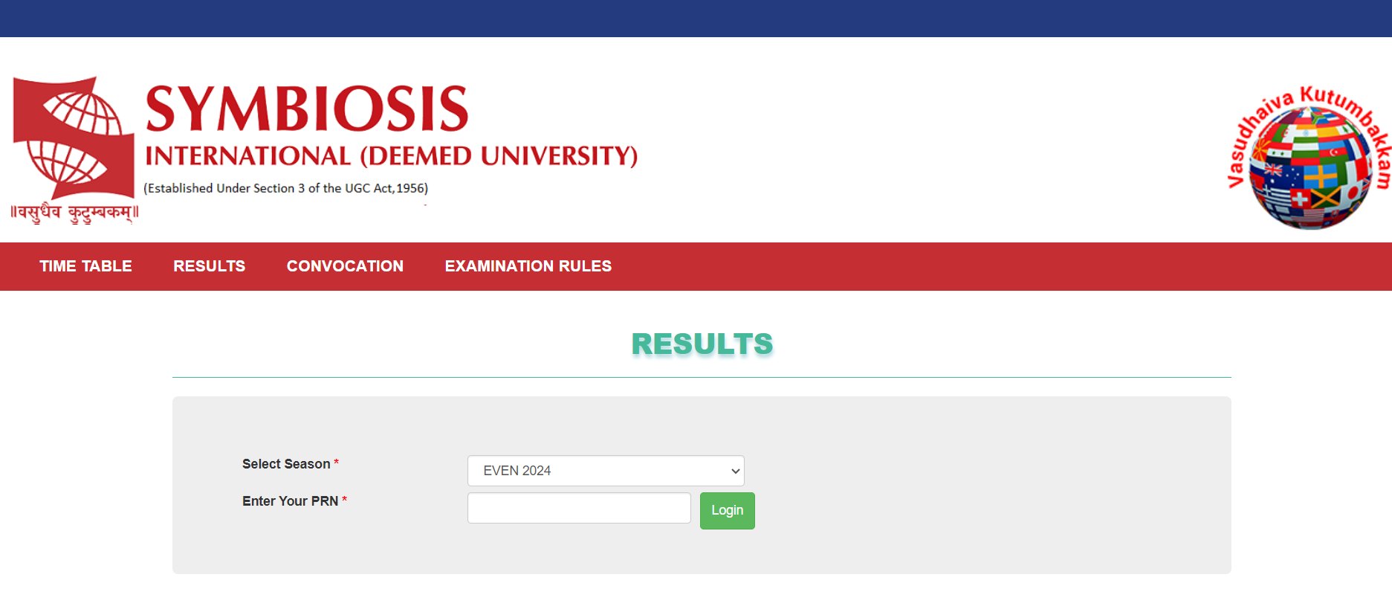
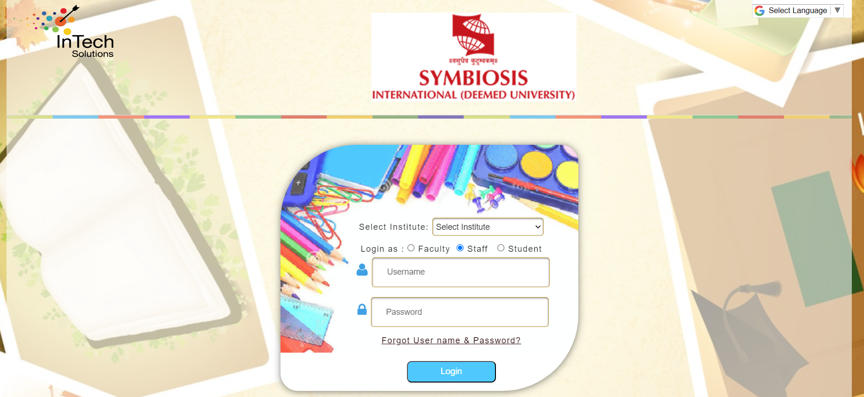
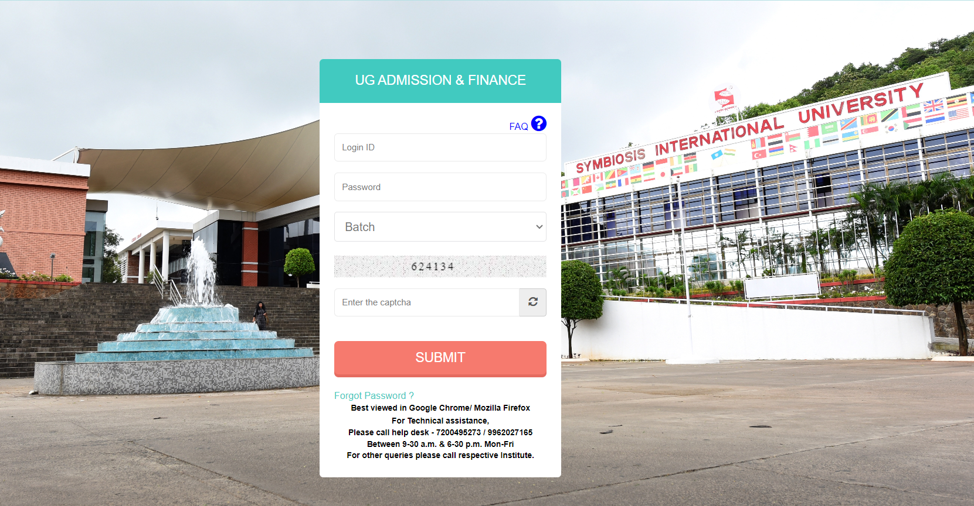
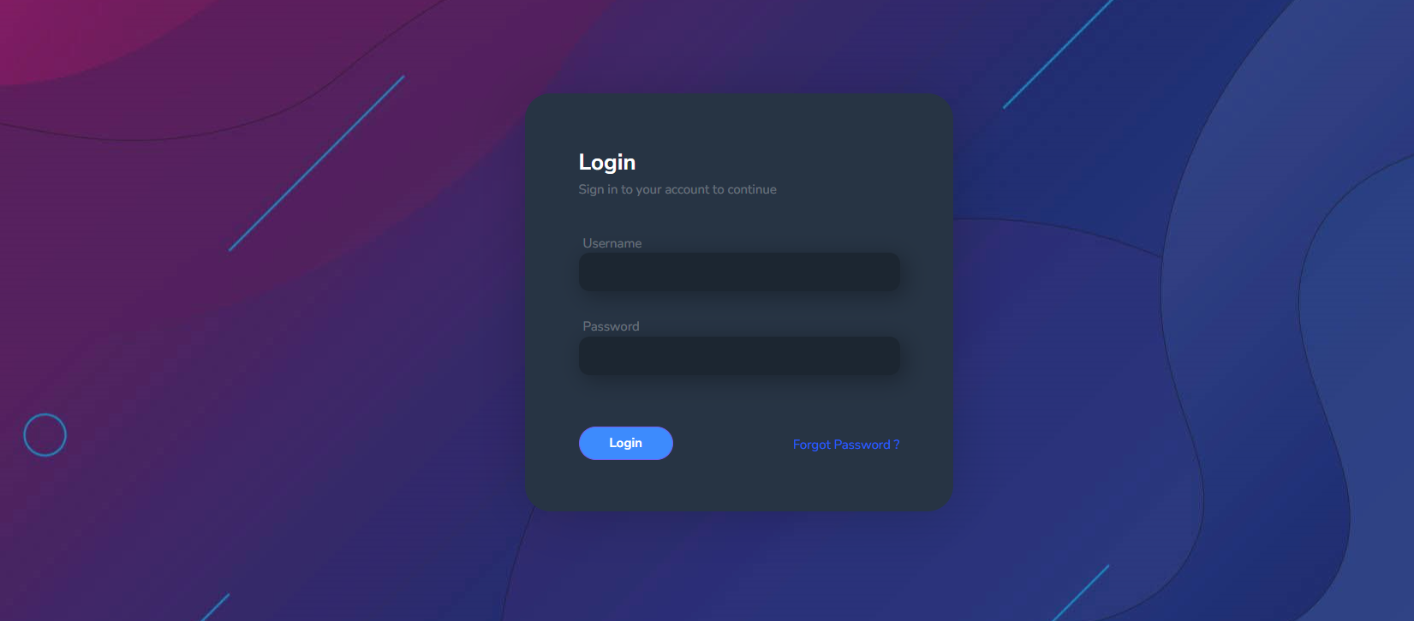
Results

Slide 17
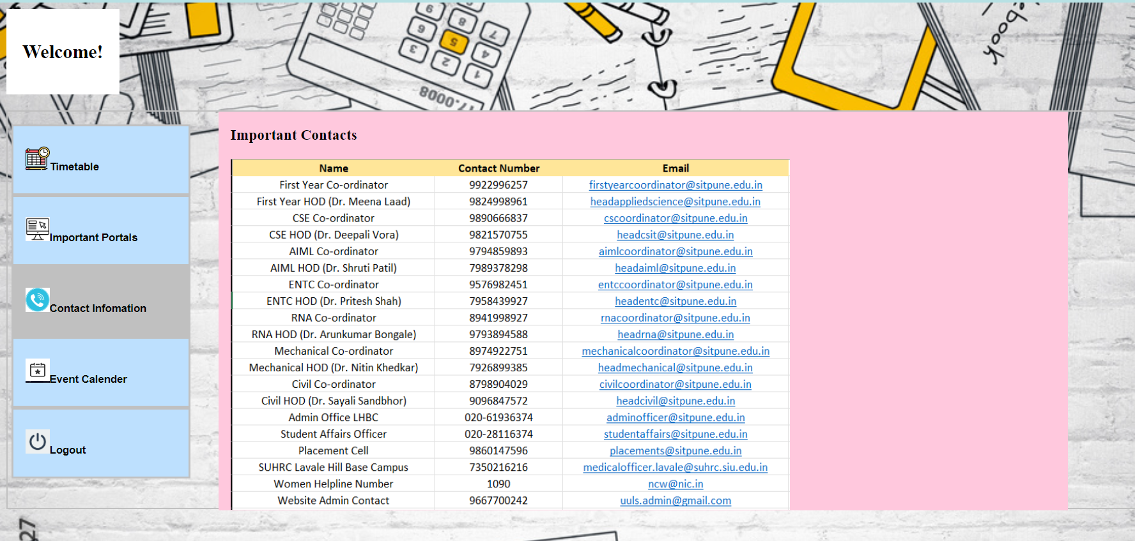
Results

Slide 18
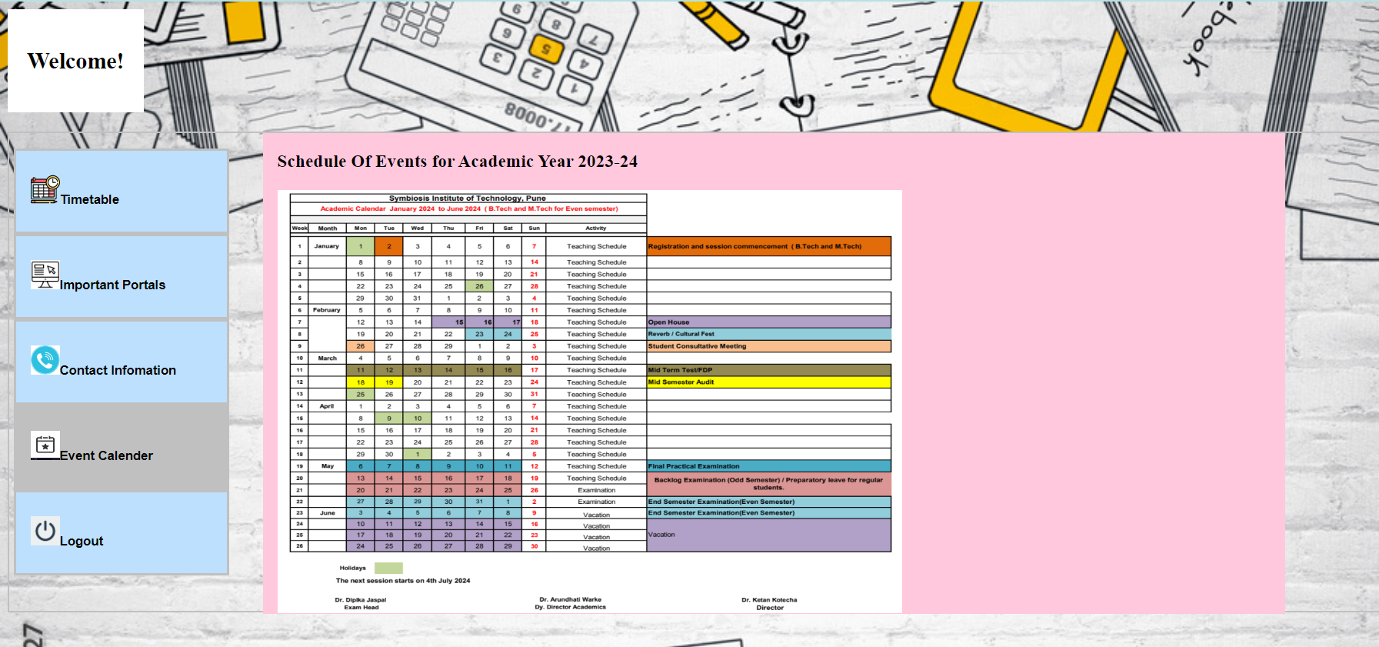
Results

Slide 19
Conclusion
Significance of Centralized Access Management.
Addressing Challenges for an Efficient and Secure System.
Future Enhancements: Additional Security Features, Service Integration.
Continuing Improvements for Scalability and Usability.
Importance of User-Centric Design and Security Measures.

Slide 20
References
IEEE RESEARCH PAPERS
https://ieeexplore.ieee.org/abstract/document/9776768
https://ieeexplore.ieee.org/document/5641460
https://ieeexplore.ieee.org/abstract/document/7233087

Slide 21
Thank You
21
Notes:
21

